Slide 1
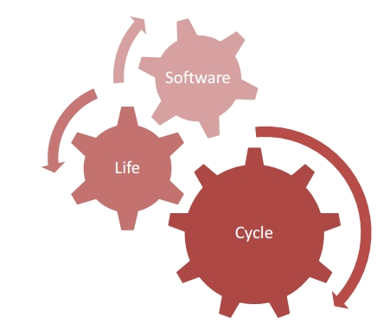
Thanjida Akhter | 201691489 | takhter@mun.ca

Slide 2
contents
Introduction
Application
Paper Review
Reference

Slide 3
What we intend
Requirements
Software

Slide 4
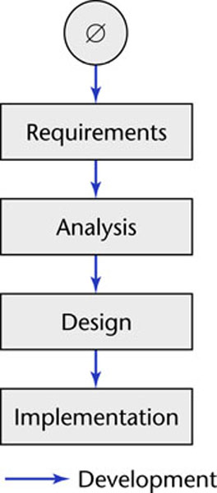
Software Development in Theory
How it should go
Linear
Starting from scratch

Slide 5
Software Development in Practice
In the real world, software development is totally different and is more chaotic
Requirements are complex
Frequent changes are difficult to manage
Software professionals make mistakes
The client’s requirements change while the software product is being developed
A software product is a model of the real world, and the real world is continually changing.

Slide 6
Software Life Cycle
The term “Lifecycle” is based on the metaphor of the life of a person:
Conception
Childhood
Adulthood
Childhood
Retirement
Pre- Development
Post- Development
Development

Slide 7
Definitions
Software life cycle:
Set of activities and their relationships to each other to support the development of a software system
Software development methodology:
A collection of techniques for building models applied across the software life cycle
Notes:
A methodology is a collection of methods for solving a class of problems and specifies how and when each method should be used.

Slide 8
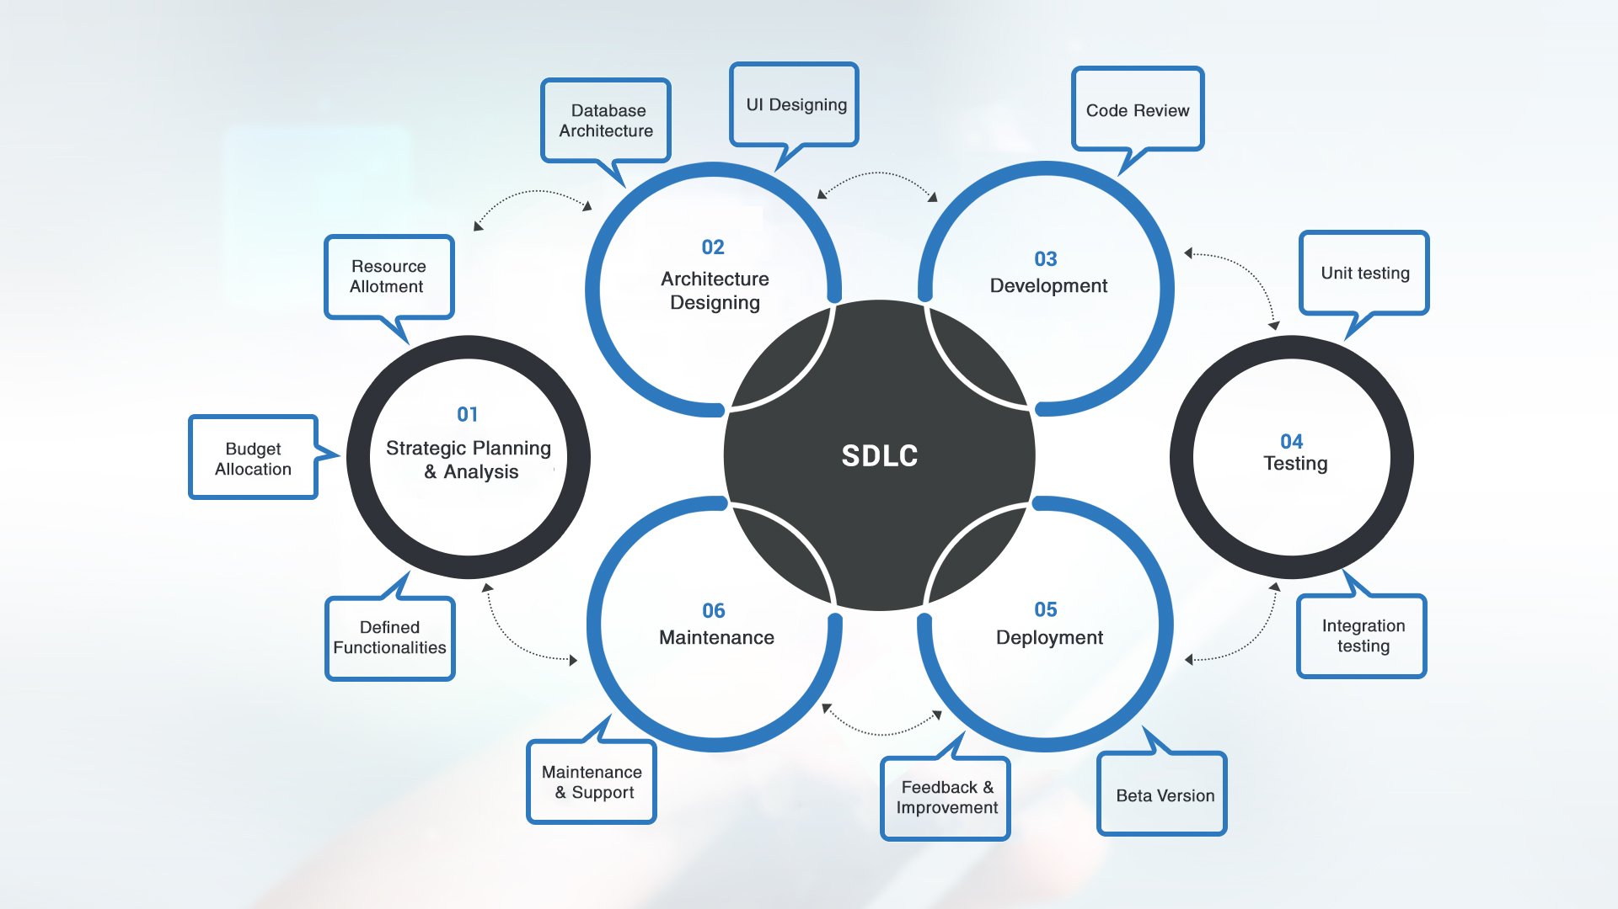
Software Life Cycle Model
.
Notes:
It specifies the various phases/workflows of the software process, such as the requirements, analysis (specification), design, implementation, and post-delivery maintenance, and the order in which they are to be carried out

Slide 9
Typical Software Life Cycle Questions
Which activities should we select for the software project?
What are the dependencies between activities?
How should we schedule the activities?
To find these activities and dependencies we can use the same modeling techniques we use for software development:
Functional Modeling of a Software Lifecycle
Scenarios
Use case model
Structural modeling of a Software Lifecycle
Object identification
Class diagrams
Dynamic Modeling of a Software Lifecycle
Sequence diagrams, state chart and activity diagrams

Slide 10
Software Development Activities
Requirements Analysis
What is the problem?
Application
Domain
System Design
What is the solution?
What are the best mechanisms
Detailed Design
to implement the solution?
Solution
Domain
Program Implementation
How is the solution
constructed?
Testing
Is the problem solved?
Delivery
Can the customer use the solution?
Maintenance
Are enhancements needed?
Notes:
Possible Identification of Software Development Activities

Slide 11
Functional Model of a simple life cycle model
Notes:
a simple life cycle for software development
using three activities: Problem definition, System development, and System operation.

Slide 12
Two Major Views of the Software Life Cycle
Activity-oriented view of a software life cycle
Software development consists of a set of development activities
Entity-oriented view of a software life cycle
Software development consists of the creation of a set of deliverables.
Notes:
The activity-centered view leads participants to focus on how work products are created.
The entity-centered view leads participants to focus on the content and structure of the work products.

Slide 13
Combining Activities and Entities in One View
Notes:
The activity-centered view and the entity-centered view are complementary, as illustrated in this slide.
For every product there is one or more activity that generates it.
The Problem definition activity uses a Market survey document as input and generates a Requirements specification document.
The System development activity takes the Requirements specification document as input and produces an Executable system.
System operation generates a Lessons learned document that could be used during the development of the next product.
Alternatively, every activity generates one or more products.

Slide 14
IEEE Std 1074:
Standard for Software Life Cycle Activities
Process Group
IEEE Std 1074
Project
Management
Pre-
Development
Development
Post-
Development
Cross-
Development
(Integral Processes)
> Project Initiation
>Project Monitoring
&Control
> Software Quality
Management
> Concept
Exploration
> System
Allocation
> Requirements
> Design
> Implementation
> Installation
> Operation & Support
> Maintenance
> Retirement
> V & V
> Configuration Management
> Documentation
> Training
Process
Notes:
A process is a set of activities that is performed towards a specific purpose (e.g., requirements, management, delivery). The IEEE standard lists a total of 17 processes. The processes are grouped into higher levels of abstractions called process groups.
Examples of process groups are project management, pre-development, development, and post-development. Examples of processes in the development process group include:
the Requirements Process, during which the developers develop the system models
the Design Process, during which developers decompose the system into components
the Implementation Process, during which developers realize each component

Slide 15
SDLC Models
Modeling the software life cycle
Sequential models
Pure waterfall model
V-model
Iterative models
Boehm’s spiral model
Unified Process
Entity-oriented models
Issue-based model

Slide 16
The Waterfall Model of the Software Life Cycle
Concept
Exploration
Process
System
Allocation
Process
Requirements
Process
Design
Process
Implementation
Process
Verification
& Validation
Process
Installation
Process
Operation &
Support Process
Notes:
The waterfall model was first described by Royse [Royce, 1970].
The waterfall model is an activity-centered life cycle model that prescribes a sequential execution of a subset of the development processes and management processes we have mentioned so far.
The requirements activities are all completed before the system design activity starts.
The goal is to never turn back once an activity is completed.
This model provides a simple (or even simplistic) view of software development that measures progress by the number of tasks that have been completed.
The model assumes that software development can be scheduled as a step-by-step process that transforms user needs into code

Slide 17
Activity Diagram
System
Requirements
Analysis
Preliminary
Design
System
Requirements
Review
Preliminary
Design Review
System
Design
Detailed
Design
System
Design
Review
Critical Design
Review (CDR)
Software
Requirements
Analysis
Software
Specification
Review
Coding &
CSC
CSU Testing
Integration
& Testing
…
Notes:
The diamond below each activity denotes a decision point: The next activity is initiated
only if the review
is successful

Slide 18
From the Waterfall Model to the V Model
Acceptance
Requirements
Engineering
Requirements
Analysis
System
Testing
System Design
Integration
Testing
Object Design
Unit
Testing
Implemen-
tation
Unit
Testing
Integration Testing
System
Testing
Notes:
The V-model is a variation of the waterfall model that makes explicit the dependency between development activities and verification activities.
The difference between the waterfall model and the V model is that the latter makes explicit the notion of level of abstraction.
All activities from requirements to implementation focus on building more and more detailed representation of the system, whereas all activities from implementation to operation focus on validating the system. This slide shows origin of the V-model form the waterfall model.

Slide 19
Activity Diagram of the V Model
Is validated by
precedes
Notes:
It shows 2 types of dependencies: Precedes (which is a temporal dependency) and “is validated by” which shows
The horizontal object flow denotes the information flow between activities of same abstraction level. The V-shape layout of the activities was conserved to reflect the original drawing.
Higher levels of abstractions of the V-model deal with the requirements in terms of elicitation and operation. The middle-part of the V-model focuses on mapping the understanding of the problem into a software architecture. The lower level of the V-model focuses on details such as the assembly of software components and the coding of new ones.
For example, the goal of the Unit Test activity is to validate units against their description in the detailed design. The Component Integration and Test activity validates functional components against the preliminary (or high-level) design. In many aspects, the waterfall model and its variants are simplistic abstractions of the software development process.

Slide 20
Properties of Waterfall-based Models
Managers love waterfall models
Nice milestones
No need to look back (linear system)
Always one activity at a time
Easy to check progress during development: 90% coded, 20% tested
However, software development is non-linear
While a design is being developed, problems with requirements are identified
While a program is being coded, design and requirement problems are found
While a program is tested, coding errors, design errors and requirement errors are found.
Notes:
In practice, software development is not sequential
The development stages overlap
The tendency to freeze parts of the development leads to systems the client does not want and which are badly structured as design problems are circumvented by tricky coding

Slide 21
Spiral Model
The spiral model proposed by Boehm has the following set of activities
Determine objectives and constraints
Evaluate alternatives
Identify risks
Resolve risks by assigning priorities to risks
Develop a series of prototypes for the identified risks starting with the highest risk
Use a waterfall model for each prototype development
If a risk has successfully been resolved, evaluate the results of the round and plan the next round
If a certain risk cannot be resolved, terminate the project immediately
This set of activities is applied to a couple of so-called rounds.
Notes:
Boehm’s spiral model [Boehm, 1987] is an activity-centered life cycle model that was devised to address the source of weaknesses in the waterfall model, in particular, to accommodate infrequent change during the software development. It based on the same activities as the waterfall model, however, it adds several activities such as risk management, reuse, and prototyping to each activity.
These extended activities are called cycles or rounds.
18

Slide 22
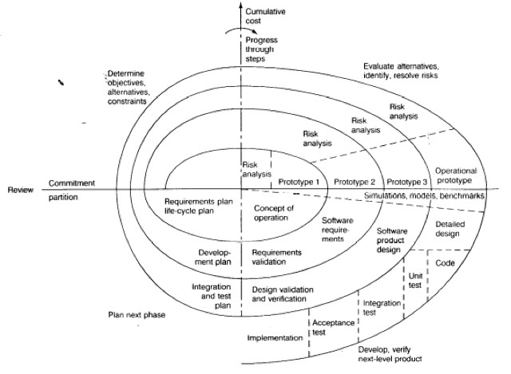
Diagram of Boehm’s Spiral Model
Notes:
The spiral model focuses on addressing risks incrementally, in order of priority.
Boehm’s spiral model distinguishes the following rounds: Concept of Operation, Software Requirements, Software Product Design, Detailed Design, Code, Unit Test, Integration and Test, Acceptance Test, Implementation
Each round is composed of four phases.
The first 3 rounds are shown in a polar coordinate system.
The polar coordinates r = (l, a) of a point indicate the resource spent in the project and the type of activity

Slide 23
Rounds in Boehm’s Spiral Model
Concept of Operations
Software Requirements
Software Product Design
Detailed Design
Code
Unit Test
Integration and Test
Acceptance Test
Implementation
For each round go through these activities:
Define objectives, alternatives, constraints
Evaluate alternatives, identify and resolve risks
Develop and verify a prototype
Plan the next round.
Notes:
Each round follows the waterfall model and includes the following activities:
Determine objectives
Specify constraints
Generate alternatives
Identify risks
Resolve risks

Slide 24
Round 1, Concept of Operations, Quadrant IV: Determine Objectives, Alternatives & Constraints
Project
Start
Notes:
During the first phase (upper left quadrant), developers explore alternatives, define constraints, and identify objectives.

Slide 25
Round 1, Concept of Operations, Quadrant I: Evaluate Alternatives, identify & resolve Risks
Risk Analysis
Notes:
During the second phase (upper right quadrant), developers manage risks associated with the solutions defined during the first phase and specify a prototype to be built in the next phase

Slide 26
Round 1, Concept of Operations, Quadrant II: Develop and Verify
Concept of Operation
Activity
Notes:
During the third phase (lower right quadrant), developers realize and validate a prototype or the part of the system associated with the risks addressed in this round.

Slide 27
Round 1, Concept of Operations, Quadrant III: Prepare for Next Activity
Requirements and
Life cycle Planning
Notes:
The fourth phase (lower left quadrant) focuses on the planning of the next round based on the results produced in the current round.

Slide 28
Round 2, Software Requirements, Quadrant IV: Determine Objectives, Alternatives & Constraints
Start
of Round 2
Notes:
The last phase of the round is usually conducted as a review involving the project participants, including developers, clients, and users. This review covers the artifacts developed during the previous and current rounds and the plans for the next round.

Slide 29
Limitations of Waterfall and Spiral Models
Neither of these models deal well with frequent change
The Waterfall model assumes that once you are done with a phase, all issues covered in that phase are closed and cannot be reopened
The Spiral model can deal with change between phases, but does not allow change within a phase
What do you do if change is happening more frequently?
“The only constant is the change”

Slide 30
An Alternative: Issue-Based Development
A system is described as a collection of issues
Issues are either closed or open
Closed issues have a resolution
Closed issues can be reopened (Iteration!)
The set of closed issues is the basis of the system model
I1:Open
A.I1:Open
SD.I1:Closed
SD.I3:Closed
I2:Closed
I3:Closed
A.I2:Open
SD.I2:Closed
Planning
Requirements Analysis
System Design

Slide 31
Waterfall Model: Analysis Phase
I1:Open
A.I1:Open
I2:Open
I3:Open
A.I2:Open
SD.I1:Open
Analysis
Analysis
SD.I3:Open
SD.I2:Open

Slide 32
Waterfall Model: Design Phase
I1:Closed
A.I1:Open
I2:Closed
I3:Open
A.I2:Open
SD.I1:Open
Analysis
Analysis
SD.I3:Open
SD.I2:Open
Design

Slide 33
Waterfall Model: Implementation Phase
I1:Closed
A.I1:Closed
I2:Closed
I3:Closed
A.I2:Closed
SD.I1:Open
Analysis
SD.I3:Open
SD.I2:Open
Design
Implementation

Slide 34
Waterfall Model: Project is Done
I1:Closed
A.I1:Closed
I2:Closed
I3:Closed
A.I2:Closed
SD.I1:Open
Analysis
SD.I3:Open
SD.I2:Open
Design
Implementation

Slide 35
Issue-Based Model: Analysis Phase
I1:Open
D.I1:Open
I2:Open
I3:Open
Analysis:80%
Imp.I1:Open
Design: 10%
Implemen-tation: 10%

Slide 36
Issue-Based Model: Design Phase
I1:Closed
SD.I1:Open
I2:Closed
I3:Open
SD.I2:Open
Imp.I1:Open
Analysis:40%
Imp.I3:Open
Imp.I2:Open
Design: 60%
Implemen-tation: 0%

Slide 37
Issue-Based Model: Implementation Phase
I1:Open
A.I1:Open
I2:Closed
I3:Closed
A.I2:Closed
Analysis:10%
SD.I1:Open
SD.I3:Open
Design: 10%
SD.I2:Closed
Implemen-tation: 60%

Slide 38
Issue-Based Model: Prototype is Done
I1:Closed
A.I1:Closed
I2:Closed
I3: Pending
A.I2:Closed
SD.I1:Open
SD.I3:Closed
SD.I2: Unresolved

Slide 39
Process Maturity
A software development process is mature
if the development activities are well defined and
if management has some control over the quality, budget and schedule of the project
Process maturity is described with
a set of maturity levels and
the associated measurements (metrics) to manage the process
Assumption
With increasing maturity the risk of project failure decreases
CMM: Capability Maturity Model (SEI,Humphrey)
Notes:
Process maturity describes a set of maturity levels at which an organizations' development process takes place. Onle when the development process possesses sufficient structure and procedures does it make sense to collect certain kind of metrics.
Why do we care about process maturity? Well, with increasing maturity we assume that the risk of project failure decreases.
There is another implicit assumption here. This one says, that if you can decompose a process into a set of development activities, you actually can handle it better. This is not necessarily true. Good examples: Mozart. We don’t know how he composed, he might not have known it himself, at least he never wrote about it. And he composed wonderful music. One of the characteristics of his person is that he was able to keep a full score in his head before writing down the final composition. There are scores written by Mozart one hour before the performance with no writing mistakes. (The fact that they were written hourse before the performance was deduced from the haste the inkblotter was pushed on the notes to dry the ink.
Mozart was able to go to a church, hear a wonderful piece of music, with a duration of half an hour, then go home and write down the exact piece of music, all voices, from memory!

Slide 40
CMM levels
1. Initial Level
Also called ad hoc or chaotic
2. Repeatable Level
Process depends on individuals ("champions")
3. Defined Level
Process is institutionalized (sanctioned by management)
4. Managed Level
Activities are measured and provide feedback for resource allocation (process itself does not change)
5. Optimizing Level
Process allows feedback of information to change process itself
Notes:
CMM does not specify any particular process model.
But it does dictate guidance on how to measure the maturity of your process, as well as outline certain Key Process Areas (KPAs) that it deems necessary for achieving different maturity levels.

Slide 41
What does Process Maturity Measure
The real indicator of process maturity is the level of predictability of project performance (quality, cost, schedule).
Level 1: Random, unpredictable performance
Level 2: Repeatable performance from project to project
Level 3: Better performance on each successive project
Level 4: Substantial improvement (order of magnitude) in one dimension of project performance
Level 5: Substantial improvements across all dimensions of project performance.
Notes:
Level 4 either
Substantially (order of magnitude) in one dimension of project performance OR
Significant in each dimension of project performance

Slide 42
Key Process Areas
There are no key process areas for Level 1
KPA Level 2: Basic software project management practice
KPA Level 3: Infrastructure for single software life cycle model
KPA Level 4: Quantitative understanding of process and deliverables
KPA Level 5: Keep track of technology and process changes
Notes:
To be able to measure the maturity of an organization,
a set of key process areas (KPA) has been defined by the SEI.
To achieve a specific level of maturity, the organization must demonstrate that it addresses all the key process areas defined for that level.
Some of these key process areas go beyond activities defined in the IEEE 1074 standard. The following slides show a mapping between maturity level and key process area
Focus of level 2 KPAs: Establish basic project management controls.
Focus of level 3 KPAs: Establish an infrastructure that allows a single effective software life cycle model across all projects.
Level 4 KPAs: Quantitative understanding of the software life cycle process and deliverables.
Level 5 KPAs: Focus: Keep track of technology and process changes that may cause change in the system model or deliverables even during the duration of a project.

Slide 43
Pros and Cons of Process Maturity
Benefits
Increased control of projects
Predictability of project cost and schedule
Objective evaluations of changes in techniques, tools and methodologies
Predictability of the effect of a change on project cost or schedule
Problems
Need to watch a lot (“Big brother“, „big sister“)
Overhead to capture, store and analyse the required information
Agile Methodologies
Deemphasize the importance of process maturity
Notes:
From Brian Noyes, http://www.fawcette.com/resources/managingdev/methodologies/cmm/default_pf.asp
The downside to CMM is that it requires a heavyweight process to meet all the guidelines for each KPA and produce all the associated artifacts necessary to get certified at a certain process maturity level. Also, interpreting specifically what you need to do or have in place to get certified at a given level can be vague and difficult.
But CMM is well recognized in the industry as a well-established measurement of process maturity, and you can find an immense amount of information through SEI's Web site and numerous books on the subject (see Resources).
In fact, a whole cottage industry has cropped up around CMM, with consultants and trainers who can help your company along the path to maturity if you can afford it. Many would argue that you can't afford to pass up the opportunity because, in the long run, achieving process maturity should save you money.
But the cost of getting there, especially with outside assistance, is significant and takes real commitment from management and the development team.

Slide 44
Frequency of Change and Choice of
Software Lifecycle Model
Change rarely occurs (MTBC » PT)
Linear Model (Waterfall, V-Model)
Open issues are closed before moving to next phase
Change occurs sometimes (MTBC ≈ PT)
Iterative model (Spiral Model, Unified Process)
Change occurring during phase may lead to iteration of a previous phase or cancellation of the project
Change is frequent (MTBC « PT)
Issue-based Model (Concurrent Development, Scrum)
Phases are never finished, they all run in parallel.
Here, PT = Project Time,
MTBC = Mean Time Between Change

Slide 45
Industry Distribution across Maturity Levels
Maturity Level | Frequency
Initial Repeatable Defined Managed Optimizing | 70% 15% < 10% < 5% < 1%
*State of the Software Industry in 1995)
*Source: Royce, Project Management, page 364

Slide 46
advantages and disadvantages
Advantages | Disadvantages
Applicable to complex projects. Provides a common framework. Defines expectations with Business Areas and ensures their written approval. Work for outsourced contracts. Can have different teams and specialization for each phase | Not applicable at all to simple or evolutionary projects. If the scope is not too big adds a lot of overhead and cost. Humans are not really good at defining everything in detail before seeing it. This requires a high level of abstraction. Sometimes add complex and not used scope: “Let´s add this, just in case” Not applicable to the new digital environment.

Slide 47
Paper Review
ISO/IEC 29110 standard
“Lifecycle profiles for Very Small Entities”

Slide 48
Why standards are important?
“Standards emphasize communication and shared understanding more than anything”
Benefits provided by certification for Very Small Enterprises
Increased competitiveness
Greater customer confidence and satisfaction
Greater software product quality
Increased sponsorship for process improvement
Decreased development risk
Facilitation of marketing (e.g. better image)
Higher potential to export

Slide 49
Current situation
Although commercial SPI models (such as CMMI) have been highly publicized and marketed, they are not being widely adopted and their influence in the software industry remains more at a theoretical level.
In the worldwide during March 2008 to March 2011, only less than 3,500 individual appraisals for CMMI were reported
The majority of small and very small software organizations are not adopting standards such as CMMI.

Slide 50
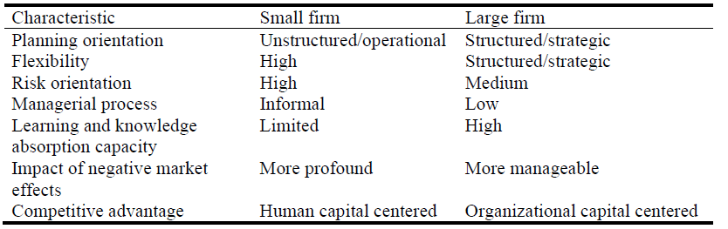
Definition of Very Small Enterprises (VES)
In this standard, VES refers to “any IT services, organizations and projects with between 1 and 25 employees”.
Characteristic of a VSE

Slide 51
Characteristic of a VSE
Finance:
VSEs are economically vulnerable as they are driven by cash-flow and depend on project profits, so they need to perform the projects within the budget.
Customer:
Typically, the VSEs product has a single customer, where the customer is in charge of the management of the system, the software integration, installation and operation.
Internal Business Processes:
usually focused on developing custom software systems, where the software product is elaborated progressively and which typically does not have strong relationship with other projects.
4. Learning and Growth:
A lack of knowledge (or acceptance) of software process assessment and improvement and a lack of human resources to engage in standardization.

Slide 52
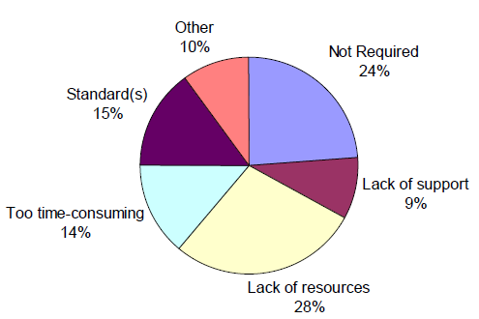
Reason for VSEs unwilling to use standards
Survey
Total 392 responders, 228 are enterprises with 0 to 25 employees (58%).
Less than 18% of VSEs are certified. Among the certified VSEs, 75% do not use standards.
Why VSEs do not use standards

Slide 53
Aims
Addressing the issues identified above and addresses the specific needs of VSEs
Developing steps
Select ISO/IEC12207 process subset applicable to VSEs of less than 10 employees
Tailor the subset to fit VSE needs
Develop guidelines

Slide 54
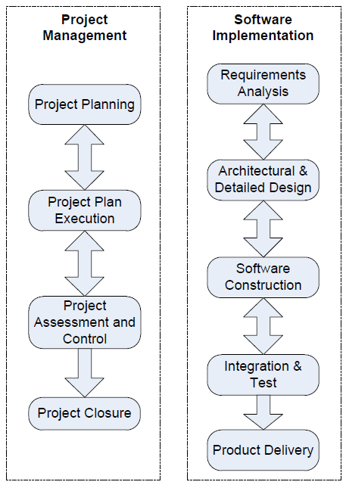
Core Part
The core of this standard is a Management and Engineering Guide (ISO/IEC 29110-5) focusing on Project Management and Software Implementation.

Slide 55
Deployment assistance
Deployment packages
Including description of processes, activities, tasks, roles and products, template, checklist, example, reference and mapping to standards and models, and a list of tools.
Packages are designed such that a VSE can implement its content, without having to implement the complete framework at the same time
Implementation guides
In addition a series of Implementation Guides have been developed to help implement a specific process supported by a tool and are freely available

Slide 56
Pilot projects
Accelerate the adoption and utilization of ISO/IEC 29110 by VSEs around the world
Reduce risks and learning more about the organizational and technical issues associated with the deployment of new software engineering practices

Slide 57
Pilot projects
Data collection
Effort and time to deploy by the VSE
Usefulness for the VSE
Verification of the understanding of the VSE
Self-assessments data - A self-assessment at the beginning of the pilot and at the end of the pilot project DP
One pilot project was conducted with a 14-person VSE based in France,
which successfully implemented ISO/IEC 29110 processes practices utilizing the available Deployment Packages.

Slide 58
Reference
https://melsatar.blog/2012/03/15/software-development-life-cycle-models-and-methodologies/
Claude Y. Laporte, Simon Alexandre, and Rory V. O'Connor. A Software Engineering Lifecycle Standard for Very Small Enterprises, Software Process Improvement : 15th European Conference, 2008
Rory V. O’Connor , Claude Y. Laporte. Using ISO/IEC 29110 to Harness Process Improvement in Very Small Entities. Workshop on SPI in SMEs, 18th European Software Process Improvement Conference, CCIS Vol. 172, Springer-Verlag, June 2011
https://www.quora.com/What-are-the-benefits-of-using-a-software-development-life-cycle-SDLC
https://melsatar.blog/2012/03/15/software-development-life-cycle-models-and-methodologies/

Slide 59


